Slide 1


OGE YEAR IN REVIEW

Slide 2
Agency meetings and other consultation
(since September 2014)
2635 subpart B
September 2014: discussions at prior OGE summit
February 2015: two meetings
2635 subpart F
September 2014: discussions at prior OGE summit
February 2015: meeting
Part 2634
June 2015: two meetings
Part 2638
April 2015: focus group meeting and subsequent follow-up
May 2015: three meetings
June 2015: conference call and circulation of new draft
July 2015: CIGIE meeting
July-August 2015: various individual agency meetings
Revision of OGE Regulations
2634
2638
Start
Subpart F
Subpart B
Analysis
Analysis, drafting, agency consultation
Initial drafts
Agency meetings
Ongoing revisions

Slide 3
Agency meetings and other consultation
(since September 2014)
2635 subpart B
September 2014: discussions at prior OGE summit
February 2015: two meetings
2635 subpart F
September 2014: discussions at prior OGE summit
February 2015: meeting
Part 2634
June 2015: two meetings
Part 2638
April 2015: focus group meeting and subsequent follow-up
May 2015: three meetings
June 2015: conference call and circulation of new draft
July 2015: CIGIE meeting
July-August 2015: various individual agency meetings
Revision of OGE Regulations
2634
2638
Start
Subpart F
Subpart B
Analysis
Analysis, drafting, agency consultation
Initial drafts
Agency meetings
Ongoing revisions

Slide 4
Final Rule Published
Analyze comments
Further revisions
Consult DOJ/OPM/ OMB (if needed)
Receive comments
Proposed
Rule
60-day public
comment period
Respond to OMB; OMB shares w/ agy
OMB sends comments to OGE
Work out
differences
Subpart B
Publish Proposed Rule in Federal Register
90-day OMB Review Process
(E.O. 12866)
Agencies respond to OMB
2634
2638
Subpart F
Consult w/ DOJ, OPM
Call w/ OMB
Submit in ROCIS; OMB receives
OMB sends draft to agencies

Slide 5
Final Rule Published
Analyze comments
Further revisions
Consult DOJ/OPM/ OMB (if needed)
Receive comments
Subpart B
Proposed
Rule
60-day public
comment period
Subpart F
Respond to OMB; OMB shares w/ agy
OMB sends comments to OGE
2638
Work out
differences
Publish Proposed Rule in Federal Register
90-day OMB Review Process
(E.O. 12866)
Agencies respond to OMB
Consult w/ DOJ, OPM
Call w/ OMB
2634
Submit in ROCIS; OMB receives
OMB sends draft to agencies

Slide 6
Subpart B
Final Rule Published
Analyze comments
Further revisions
Consult DOJ/OPM/ OMB (if needed)
Receive comments
Proposed
Rule
60-day public
comment period
Subpart F
Respond to OMB; OMB shares w/ agy
OMB sends comments to OGE
2638
Work out
differences
Publish Proposed Rule in Federal Register
90-day OMB Review Process
(E.O. 12866)
Agencies respond to OMB
Consult w/ DOJ, OPM
Call w/ OMB
2634
Submit in ROCIS; OMB receives
OMB sends draft to agencies

Slide 7
Subpart B
Final Rule Published
Analyze comments
Further revisions
Consult DOJ/OPM/ OMB (if needed)
Receive comments
Proposed
Rule
60-day public
comment period
Respond to OMB; OMB shares w/ agy
OMB sends comments to OGE
2638
Work out
differences
Subpart F
Publish Proposed Rule in Federal Register
90-day OMB Review Process
(E.O. 12866)
Agencies respond to OMB
Consult w/ DOJ, OPM
Call w/ OMB
2634
Submit in ROCIS; OMB receives
OMB sends draft to agencies

Slide 8
Subpart B
Final Rule Published
Analyze comments
Further revisions
Consult DOJ/OPM/ OMB (if needed)
Receive comments
Proposed
Rule
60-day public
comment period
2638
Respond to OMB; OMB shares w/ agy
OMB sends comments to OGE
Work out
differences
Subpart F
Publish Proposed Rule in Federal Register
90-day OMB Review Process
(E.O. 12866)
Agencies respond to OMB
Consult w/ DOJ, OPM
Call w/ OMB
2634
Submit in ROCIS; OMB receives
OMB sends draft to agencies

Slide 9
Legal Advisories
I. The Standards of Conduct as Applied to Personal Social Media Use
II. Employee Reference to Official Title in Their Personal Capacity
III. Guidance on the Application of Gift Exceptions:
A. Widely Attended Gatherings:
i. Free Attendance at Speaking Engagements
ii. “Market Value” When no Fee is Charged to Attend
B. Gift Cards under the $20 De Minimis Gift Exception

Slide 10
Legal Advisories Continued
IV. Diversified and Sector Real Estate Funds (Exemption under 5 C.F.R. § 2640.201)
V. Employee Benefit Plans Through Which Employees Hold Diversified Pooled Investment Funds and Employee Benefit Plans Established or Maintained Outside of the United States
VI. Financial Disclosure Requirements for Pooled Investment Funds

Slide 11
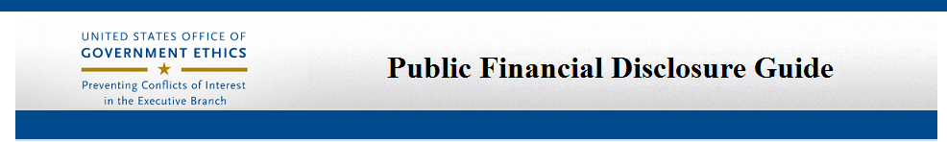
Web-based (Public Financial Disclosure section of OGE’s website)
Replaces
Nominee & New Entrant 278 Guide
Public Financial Disclosure: A Reviewer’s Reference
Covers
Nominee and New Entrant Reports
Annual Reports
Termination Reports
Periodic Transaction Reports
For Ethics Officials

Slide 12
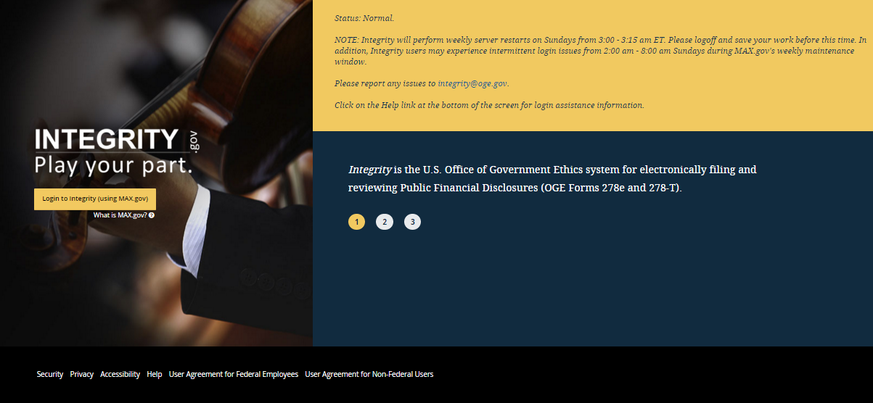

Slide 13
STOCK ACT
Sec. 11 (b)Electronic Filing and Online Public Availability of Financial Disclosure Forms of Certain Executive Branch Employees.—
(1) In General.—Subject to paragraph (6), and not later than 18 months after the date of enactment of this Act, the President, acting through the Director of the Office of Government Ethics, shall develop systems to enable—
(A) electronic filing of reports required by section 103 of the Ethics in Government Act of 1978 (5 U.S.C. App. 103), other than subsection (h) of such section;

Slide 14
INTEGRITY
Development started June 2013
Officially launched January 1, 2015

Slide 15

IT WORKED!!

Slide 16
Going forward:
Upcoming filing season
Presidential transition and nominees

Slide 17
INTEGRITY RESOURCES
Summit Sessions:
Integrity Nominee Functionality
Integrity 101
Integrity Q&A
Help Desk Kiosk

Slide 18



Slide 19
Why am I here?
Surveys: Q + Pledge
Updates since last Summit
Highlights of 2014 Q
Preview 2015 Pledge

Slide 20
What’s New?
Information Dissemination
All Reports Available Online
Means:
Benchmarking for Agencies
Transparency for the Public
Secondary Research
Reports: Summary + Comprehensive

Slide 21
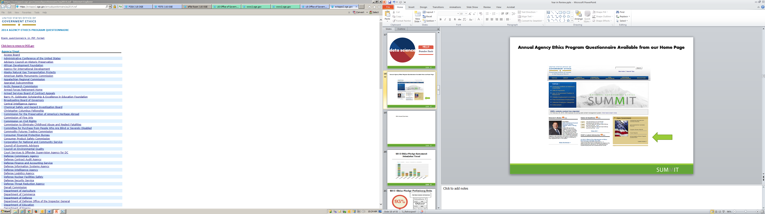
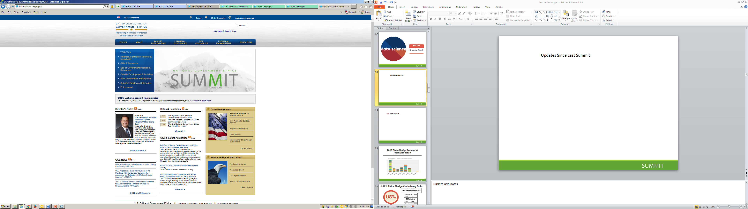
Annual Agency Ethics Program Questionnaire Available from our Home Page

Slide 22
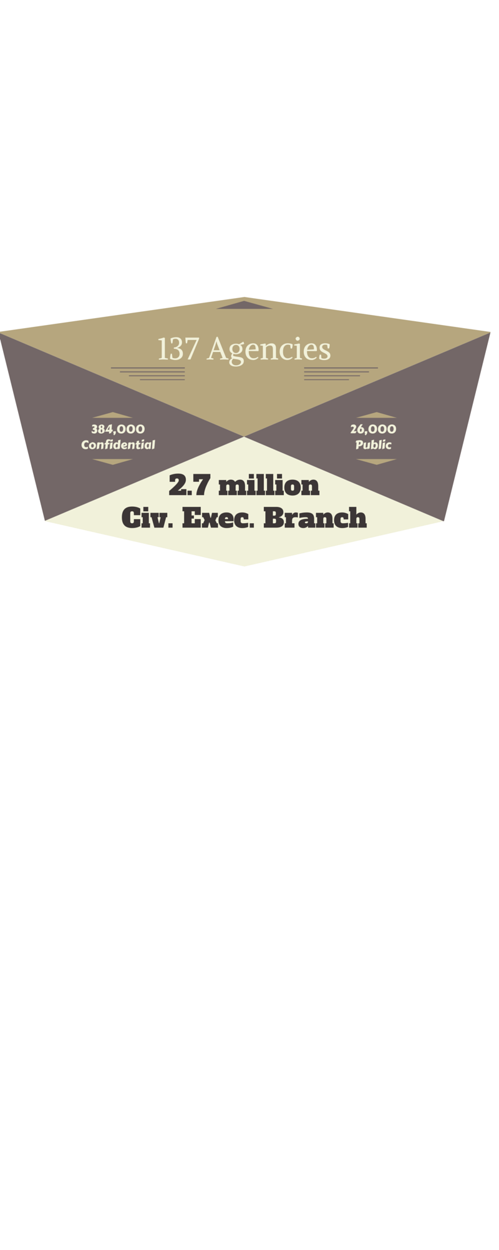


2014 Annual Agency Ethics Program Questionnaire Highlights

Slide 23
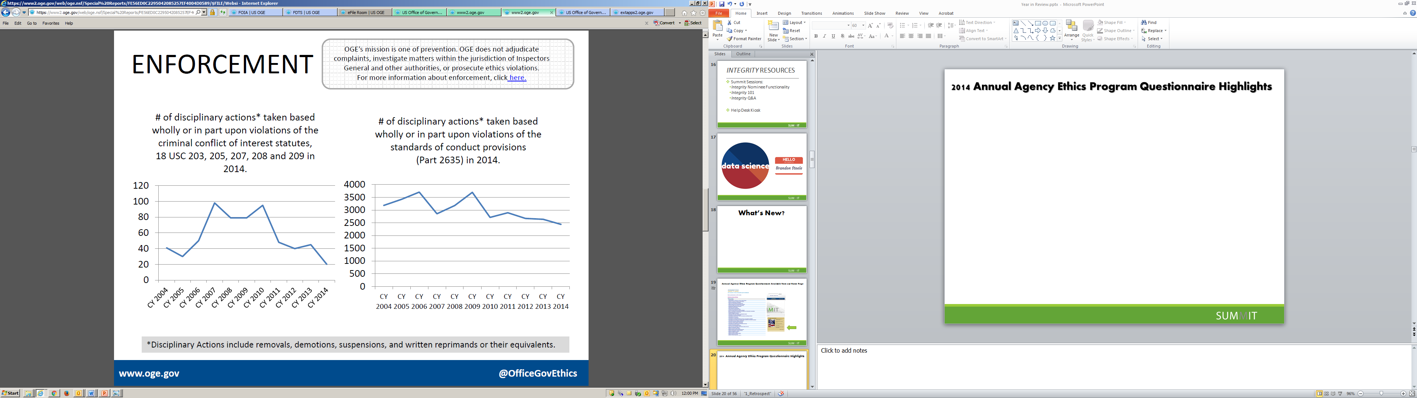
2014 Enforcement Numbers

Slide 24
Reporting for 2015 Coming Soon

Slide 25
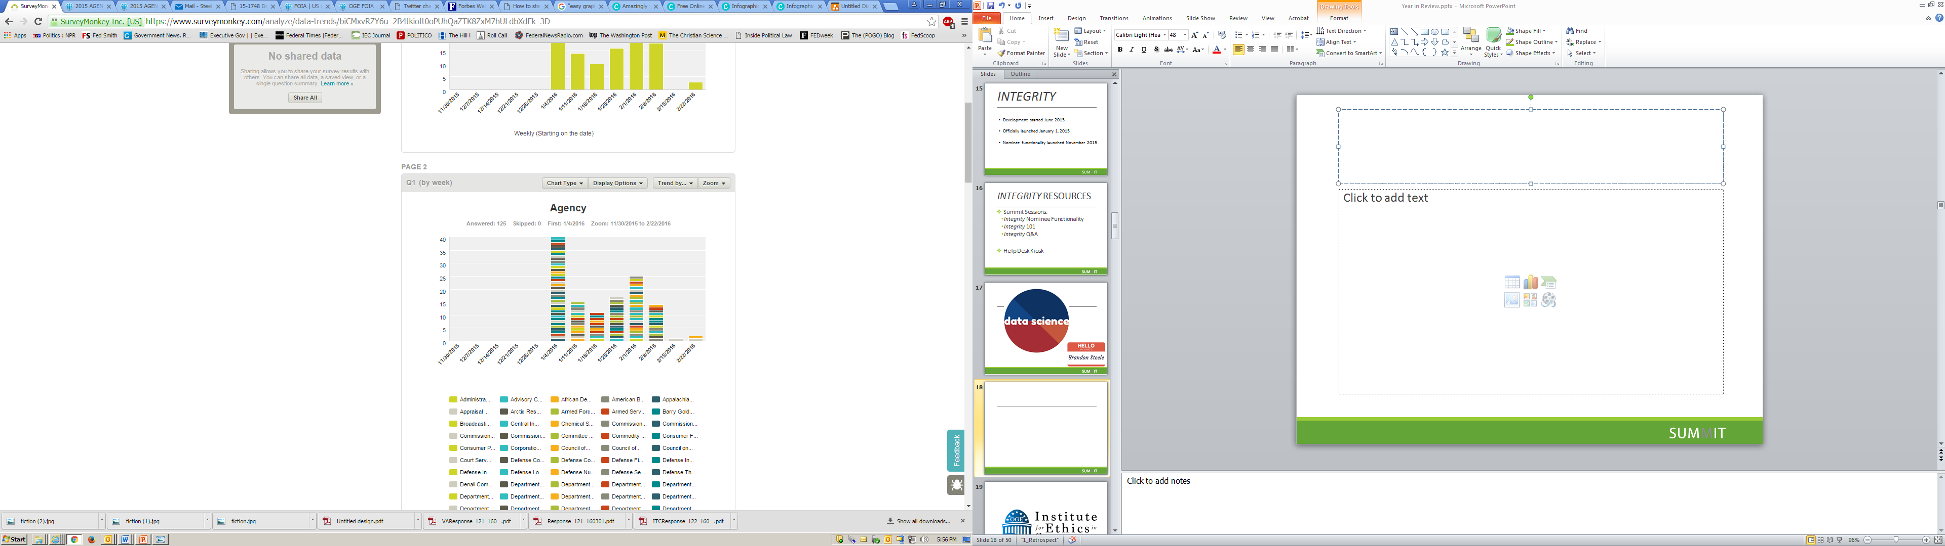
2015 Ethics Pledge Assessment Submission Trend

Slide 26
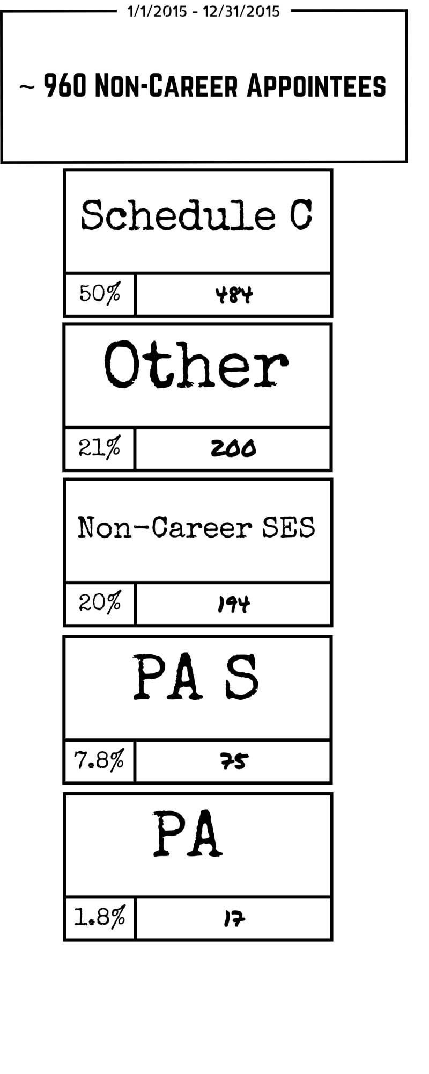

2015 Ethics Pledge Preliminary Data
Reporting

Slide 27
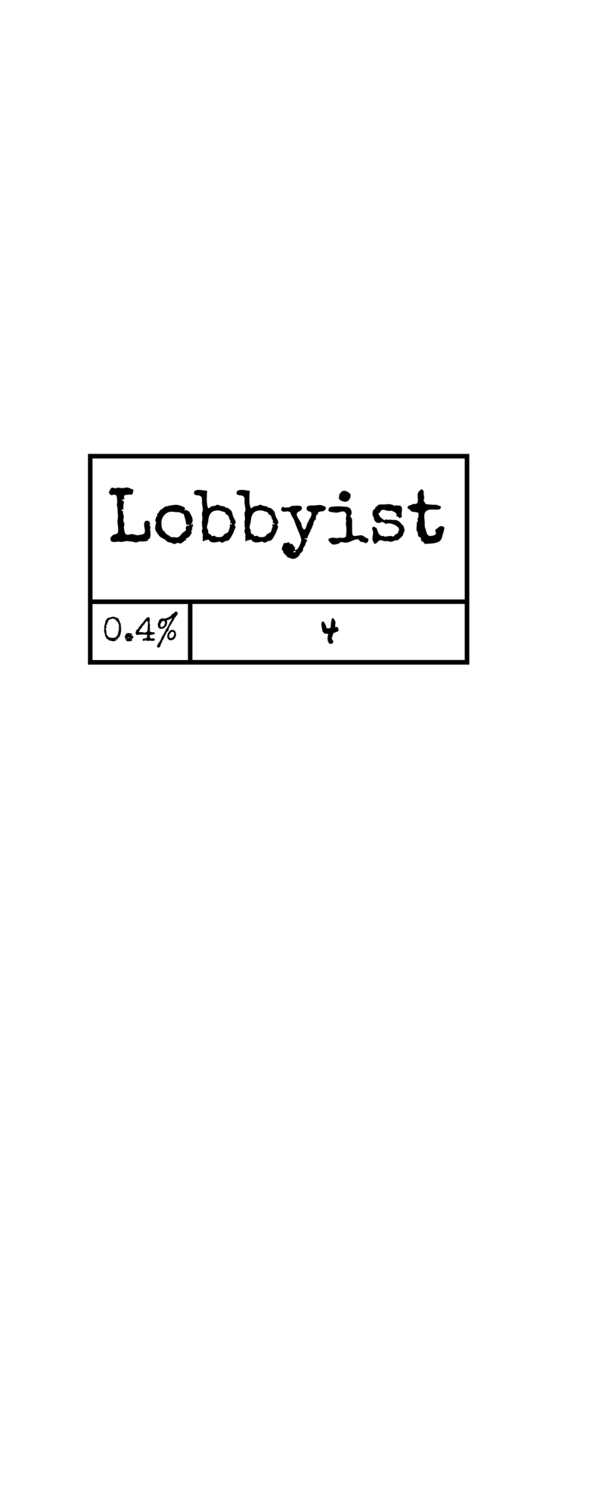

in Compliance with Ethics Agreement Requirements

Slide 28
Coming Soon…
Follow-up by me on Pledge
Follow-up by Desk Officer on Q
Reports

Slide 29

Thank You!!!!!
And now for…
Cheryl
(Spoiler Alert: she listens)

Slide 30


Slide 31


Slide 32
You Asked for :
ClassroomTraining

Slide 33

You Got It:
Regional Symposia
14
Spring Workshops
Intensive Curriculum for
New Ethics Officials

Slide 34
You Asked for :
Training Products

Slide 35

You Got It:
Employee
Scenarios

Slide 36
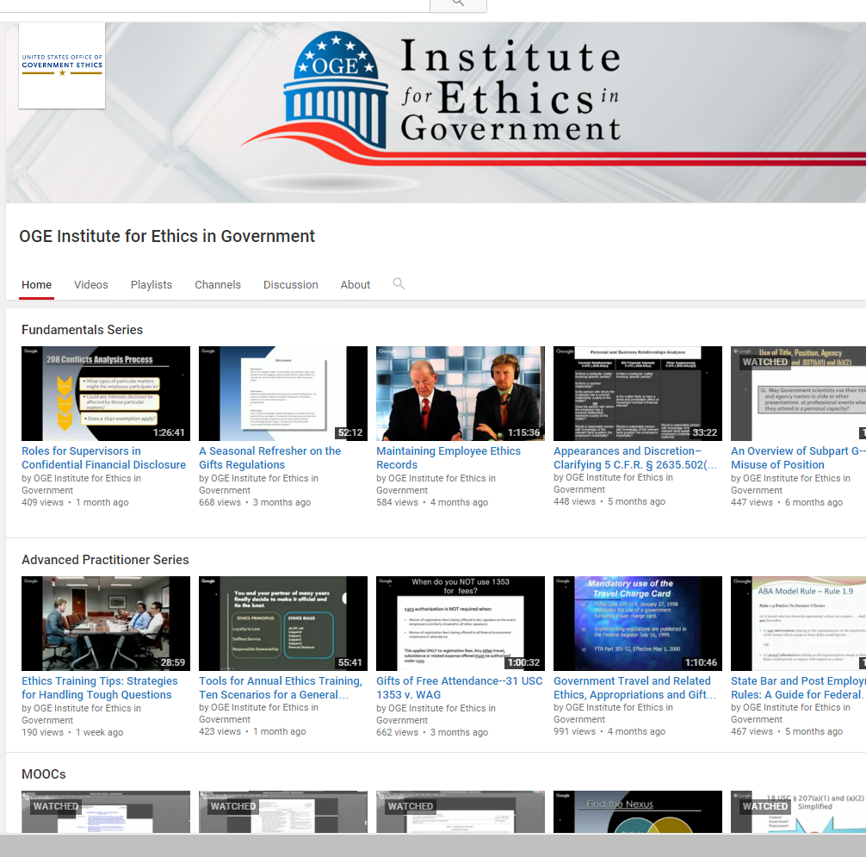

Staff Training Videos

Slide 37
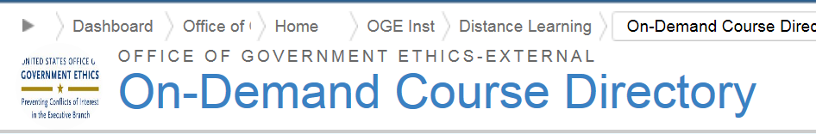
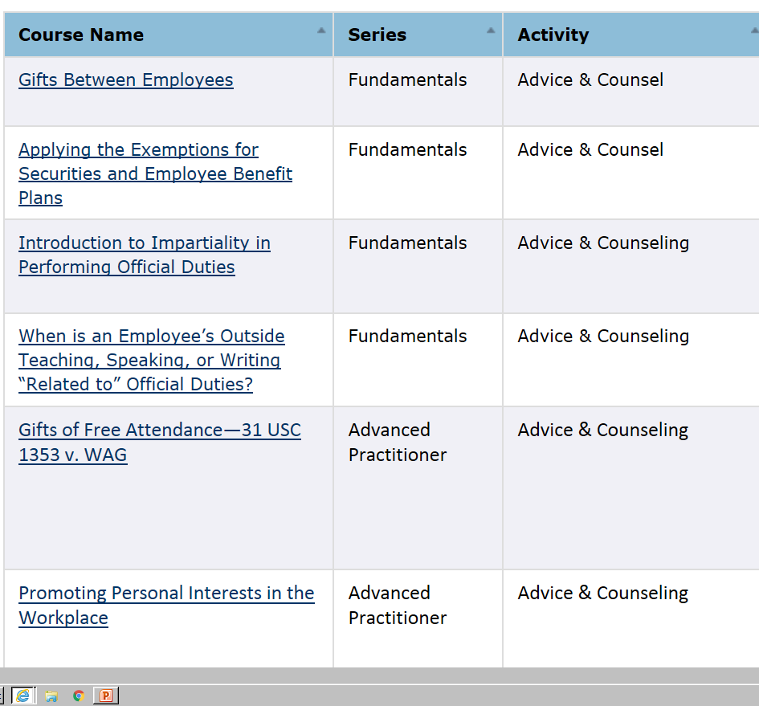
Staff Training
Materials

Slide 38

You Also Got:
34
Monthly
Learning Series
& MOOCs

Slide 39
What’s Coming? (You might ask)
Training Products

Slide 40
More…
Employee
Scenarios

Slide 41

NEW….
Handbook
Summaries
Training Scenarios
Instructor Guide

Slide 42
What Else is Coming? (You might ask)
ClassroomTraining

Slide 43

How to Conduct:
IEO
Annual Training

Slide 44

Strategic Foresight Exercises
Brainstorming Training Scenarios

Slide 45
You’ll Also Get:
12
Monthly
Learning Series
and the 278e MOOC

Slide 46
Want More ?
You Tell Us!

Slide 47


Slide 49
Compliance Division
Where have we been and where are we going?
Notes:
Introduce self
I recognize that this is supposed to be the Year in Review, not a year of review so I’ll make sure that we wrap up on time so that everyone can take a break and enjoy their lunch.
For the next 10 minutes or so I’m going to briefly re-cap what the Compliance Division has been up to for the last year and a half that touch a bit on some of our plans for the future.

Slide 50
Compliance Division
Program Review Branch
Notes:
Going to start with a recap of the Program Review Branch.

Slide 51
Compliance Division Program Review Branch – A Look Back
59 reports issued in FY ‘15
Reports included 122 recommendations
71 (58%) related to financial disclosure
31 (25%) related to education and training

Slide 52
Compliance Division Program review Branch – A Look Back
24 reports issued to date in FY ’16
Reports include 18 recommendations
10 (56%) related to financial disclosure
5 (28%) related to education and training
Notes:
Probably no great surprises here: In the Annual Agency Ethics Program Questionnaire that OGE administer, financial disclosure and ethics training are routinely reported as areas in which agencies devote a significant amount of resources.
And the reason is that these are often large elements of the program that can be very difficult to manage.
I guess the take-away here is that you must be vigilant!
So, these might be areas you might want to take a close look at, both for purposes of undergoing a program review and, more importantly, for the sake of the overall health of your program.
Whether you will be undergoing an Inspection or Plenary or even if you’ve recently been reviewed, our Inspection form—which I’m going to talk about more in just a bit--is a great tool to use to conduct a self-assessment of your own program.

Slide 53
Compliance Division Program Review Branch – A Look Back
Rise of the Inspections!
Notes:
Inspections-Started in full in 2015
I had some reservations about Inspections at first
Not about the process, but rather about the reporting format
Format could lead the un-initiated that OGE was significantly scaling back its review function
But, after working with the Inspections for a while, any reservations I had have disappeared.
I’ve come to conclude that, especially at a smaller agency, they are simply a more efficient use of our time and yours. I thought this was expressed very well in some feedback we received from a small agency that just underwent an Inspection. The feedback was that at a small or medium size agency, there just aren’t all the “moving parts” to the program that there are for a department-level program.
Two major differences between an Inspection and a full-blown Plenary Review:
Inspections focus on results, while Plenaries dig deeper into evaluating the processes and procedures in place to arrive at those results. For example:
An Inspection will determine that 95% of new entrant confidential reports were filed timely in 2015.
A Plenary will go further and identify the processes that the agency has in place to timely identify new entrant filers and collect their new entrant reports.
The second big difference is the way in which the results of the review are reported.
Remember: Inspections can lead to plenary where needed.

Slide 54
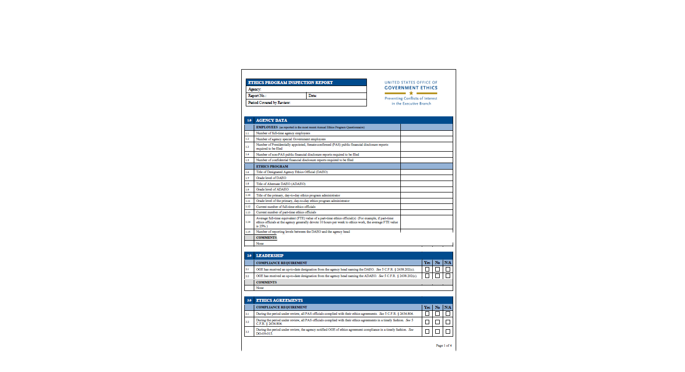
Compliance Division Review Branch – A Look Back
Notes:
Sample Inspection Report:
As you can hopefully sort of see, the Inspection report is more of a checklist indicating whether various program elements are in compliance or not.
Great for use as self assessment!

Slide 55
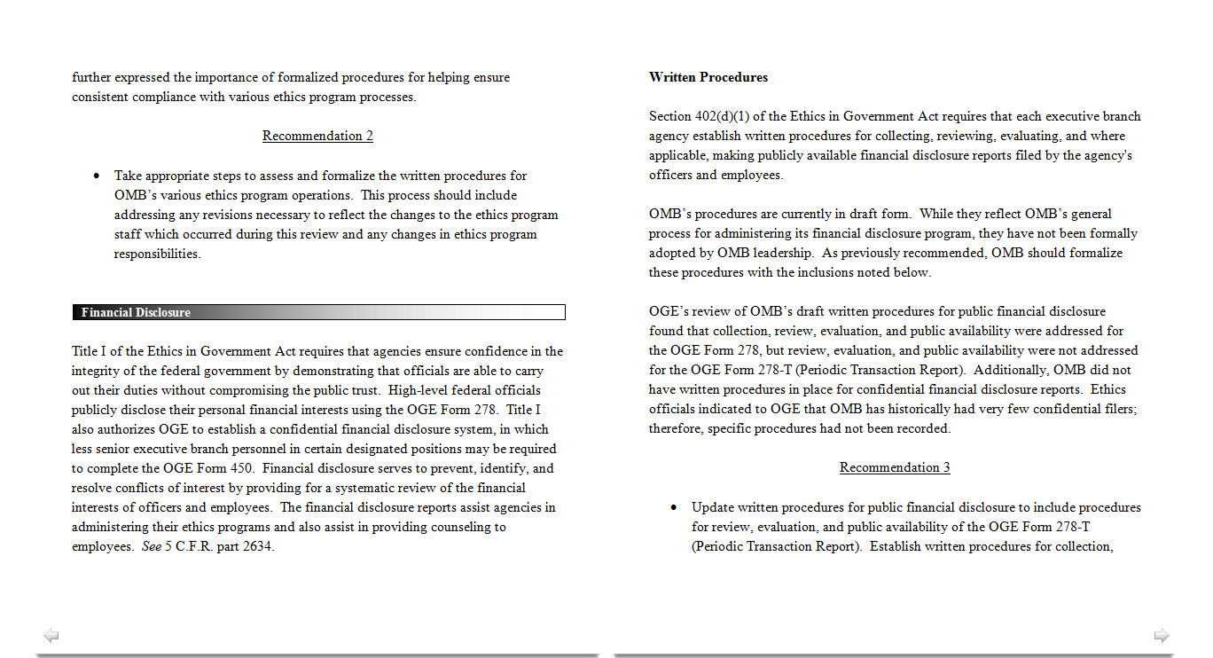
Compliance Division Program Review Branch – A Look Back
Notes:
Sample Plenary Report
More detailed explanation of the results, as well as of underlying program processes and procedures.

Slide 56
Compliance Division Program Review Branch – Looking Ahead
Planning and Scheduling Reviews with Transition in Mind
Departments and agencies w/large numbers of PAS will be reviewed this fiscal year
Allow for FY 2017 focus to be on Transition issues
Notes:
We have a mandate that we review at least every agency during the Director’s term.
With that in mind, we are working to complete as many reviews as possible in FY 2016, particularly at those departments and agencies with a number of PAS positions, in order to free up as much of your time, as well as ours, to deal with Transition issues in FY 2017.
However, we will still be carrying out ethics program reviews and other oversight functions during the Transition.
Moreover, Transition duties will not serve as a sufficient stand-alone excuse for not meeting other ethics program requirements.

Slide 57
Compliance Division
Financial Disclosure Branch

Slide 58
Compliance Division Financial Disclosure Branch - A Look Back
Total Outstanding reports as of December, 31:
2015 0
2014 22 (3 agencies)
2013 105 (15 agencies)
Notes:
I’m going to finish up by focusing on just a few items related to the Financial Disclosure Branch:
This is simply a summary of how we have improved in the timely receipt and certification of those public reports that are required to come to OGE. (Explain from bottom up).
Can’t begin to say how proud I am of the OGE staff for this or how thankful I am to all of you for making this happen.

Slide 59
Compliance Division Financial Disclosure Branch – A Look Back
2015 Annual Filing Cycle
Rate of Submission
Notes:
This is somewhat more detailed depiction of how we’ve improved in this area: This is probably a little hard to see so I’ll just point out a few notable items.
Purple Square: Earlier, more consistent and sustained rate of submission in 2015.
Orange Square: Avoided a big spike right before the end of the year, as we had in 2014, when we had to call agencies who still had outstanding reports in November, reiterating that we would be sending letters to agency heads regarding the success of their public financial disclosure programs.
Green Circle: Had 0 outstanding reports by Jan 2016!

Slide 60
Compliance Division Financial Disclosure Branch – Looking Ahead
Challenge for 2016 annual filing cycle:
Submit all required annual public financial disclosure reports to OGE by November 8--Election Day!
Notes:
Again, so that we can all focus our resources on the Transition.

Slide 61

Notes:
Thank you all for your attention and participation in this year’s Summit and we’ll see you all after lunch!

